Slide 1
N-BVH: Neural ray queries with bounding volume hierarchies
Authors: Philippe Weier, Alexander Rath, Élie Michel, Iliyan Georgiev, Philipp Slusallek, Tamy Boubekeur
Presenter: Yansong Yu
Date: 2024/07/02
Notes:
Neural rendering
Promising for data compression
Maybe MS complex
Kd
other structures

Slide 2
Background
Conventional rendering techs
Ray tracing
Prefiltering
Bounding volume hierarchy (BVH)
Neural rendering techs
NeRF (Neural Radiance Field) (2020)
Neural Radiosity (2021)
Instant-ngp (2022)

Slide 3
Ray tracing
Like rasterization, ray tracing is a technique for rendering a 3D scene to a 2D image.
Ray tracing methods can be divided into simple ones and advanced ones.

Slide 4
Ray tracing
For example, one of the simplest ray tracing method in 3D cases can be described like:
Shoot a ray R from the camera;
Find the closest intersection of R and every primitive in the scene;
If an intersection point P is found in the last step, go to next step;
Shoot a shadow ray S from P to the light to test if P is shaded by any obstacles
If P is shaded, then color the pixel to black, otherwise, use the surface properties (albedo, normal) at P and light intensity (commonly, RGB) and direction to color the pixel;
Go back to the first step.

Slide 5
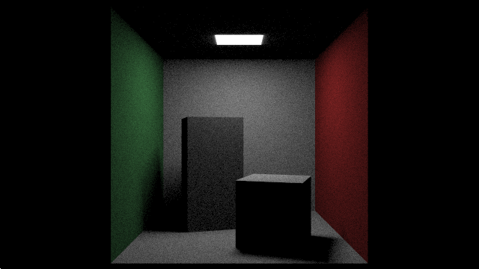
Ray tracing
From the simplest ray tracing method just mentioned, we can generate the following images. (The effect is just like simple rasterization)
https://www.shadertoy.com/view/XlGcWD

Slide 6
Ray tracing
One example from advanced ray tracing methods is called path tracing.
The relationship between path tracing and ray tracing is shown below.
Ray tracing
Path tracing

Slide 7
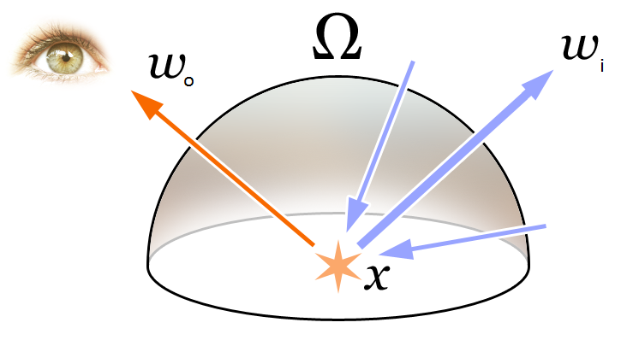
Ray tracing
Path tracing is guided by the rendering equation (James T. Kajiya. 1986.).
Rendering equation generalize the realistic rendering problem to an energy equation.
Wikipedia Contributors, “Rendering equation,” Wikipedia, Sep. 22, 2019. https://en.wikipedia.org/wiki/Rendering_equation
‌

Slide 8
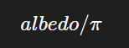
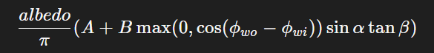
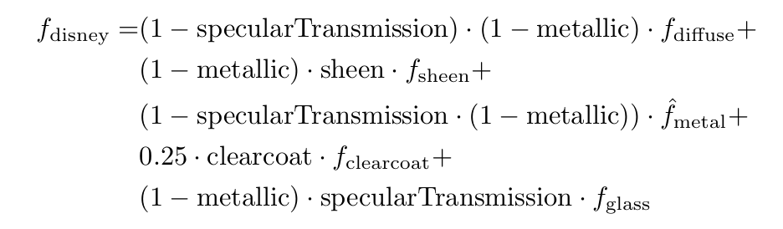
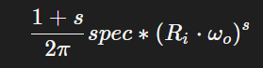
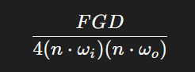
Ray tracing
Here are some BRDF, F(ω_{o}, ω_{i}) examples:
PBRT 3ed 2018 ch 8.4.1
Lambertian (Diffuse BRDF)
Oren Nayar (Diffuse BRDF)
Phong (Specular BRDF)
GGX
(Specular BRDF)
Disney BSDF
(All in one BSDF)
https://cseweb.ucsd.edu/~tzli/cse272/wi2023/homework1.pdf
Notes:
这里把详细的FGD可以贴出来，贴在以边也可以

Slide 9
Ray tracing
Take a look again on the rendering equation, it has integral and the integral is not closed, so it can not be solved analytically and directly.
Path tracing is an unbiased way to solve this equation numerically based on Monte Carlo Estimation (PBRT 3ed 2018 Ch 14.5).
In path tracing, to calculate the color of a specific pixel, multiple paths needs to be traced throughout the scene.
path: end-to-end connected line segments start from camera/eye to the light source/background, each line segment is a bounced ray.
Notes:
That’s not possible for you to just do a definite or indefinite integration on this integral
Unbiased basically means that no shortcuts are taken when calculating a render. Every ray is treated equally and there is no bias in terms of any importance whatsoever.

Slide 10
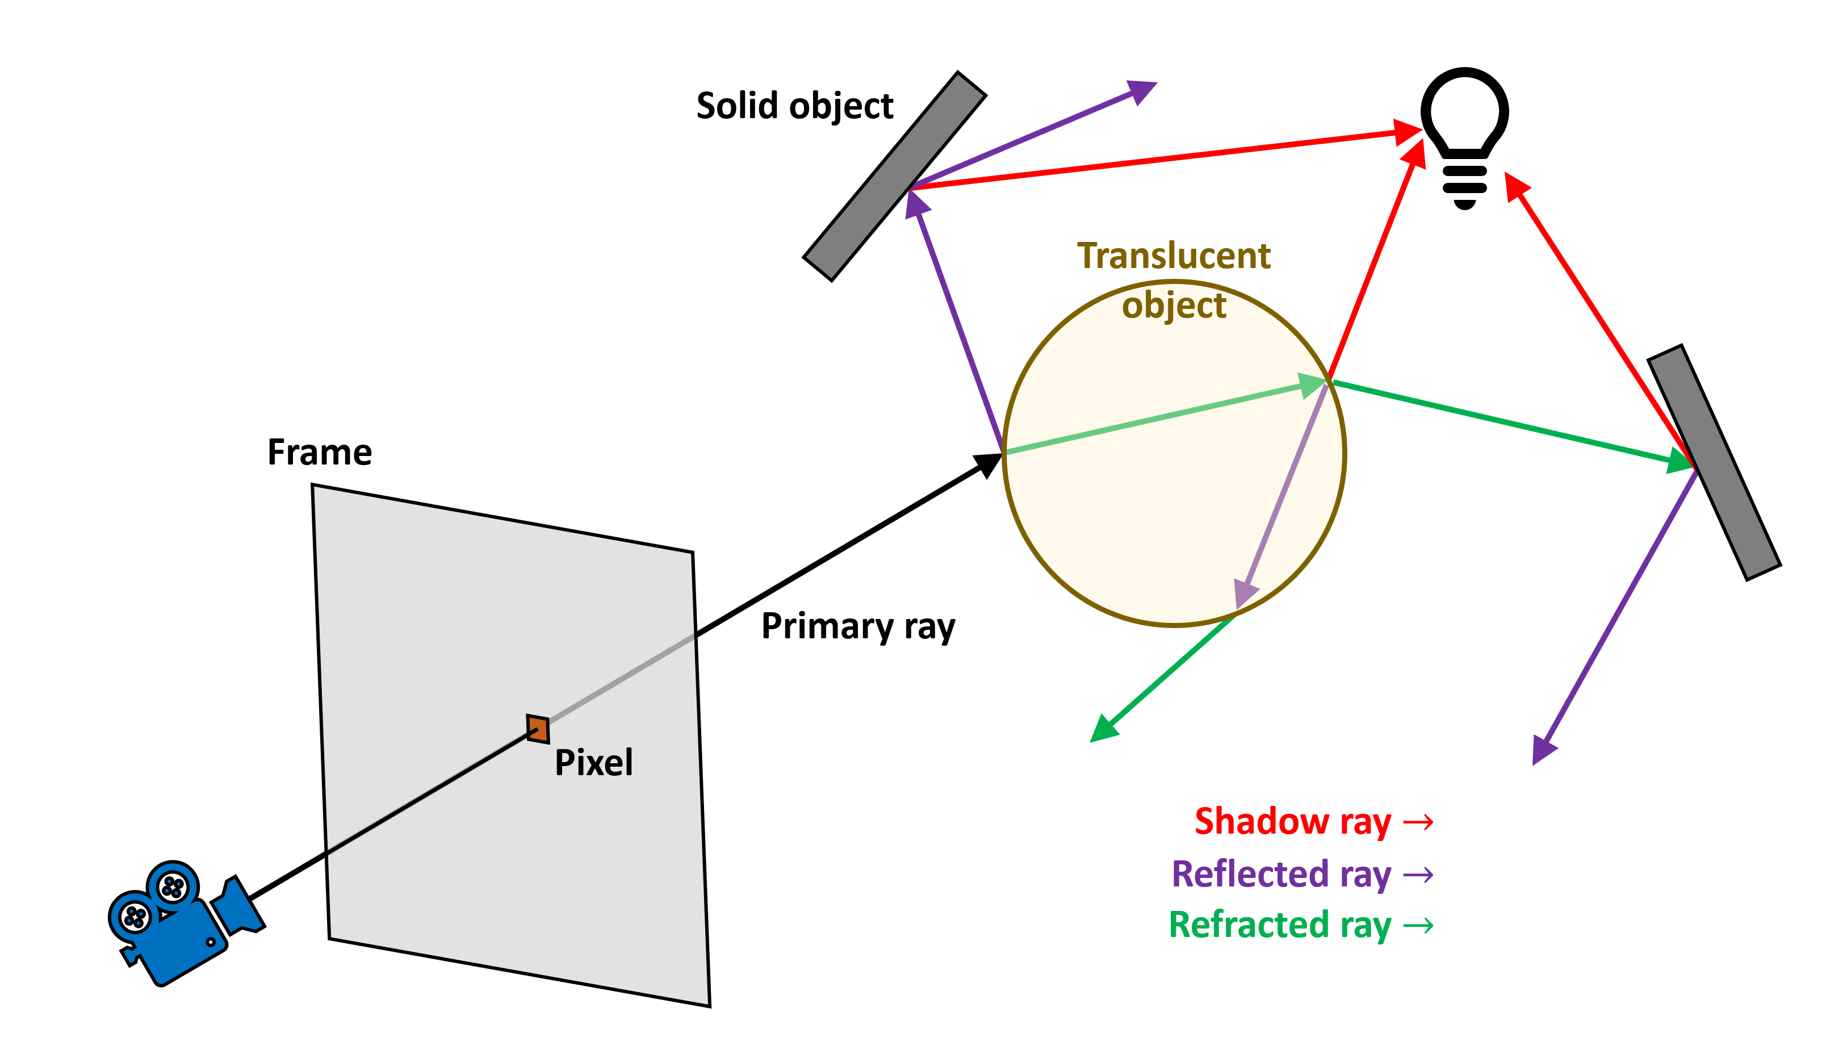
Ray tracing
The path in path tracing.
”Path Tracing vs Ray Tracing, expliqué,” www.netcost-security.fr, Jul. 11, 2022. https://www.netcost-security.fr/actualites/105890/path-tracing-vs-ray-tracing-explique/ (accessed Jun. 26, 2024).
‌

Slide 11
Ray tracing
For a single path, the routine:
P=NULL or hit a light
calculate ray R
shoot the ray
find closest P
record surface properties
multiply the attenuation to the throughput
sample new ray R_{i}
Quit.
Max bounces exceed
Notes:
surface properties: normal, material (BRDF, BSDF)

Slide 12
Ray tracing
Then, the color of pixel_{i, j}:

Slide 13
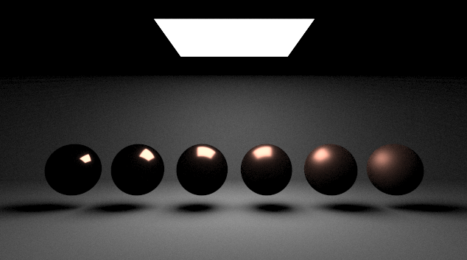
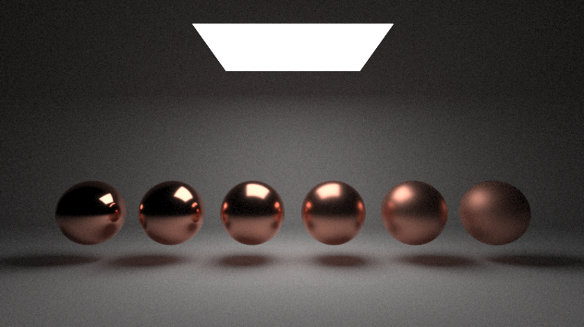
Ray tracing
Here is an intuitive comparison between path tracing and ray tracing in simplest case.

Slide 14
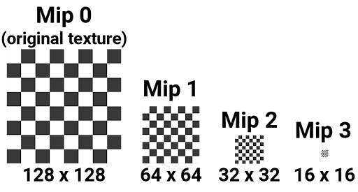
Prefilering
From my understanding, “Mipmap” falls into this category.
https://docs.unity.cn/cn/2021.3/Manual/texture-mipmaps-introduction.html
Notes:
The difference is that the information contained in each level become less and less, so the frequancy become lower and lower.
The intuitive thought is that when we scale down the original texture to 3 different levels,

Slide 15
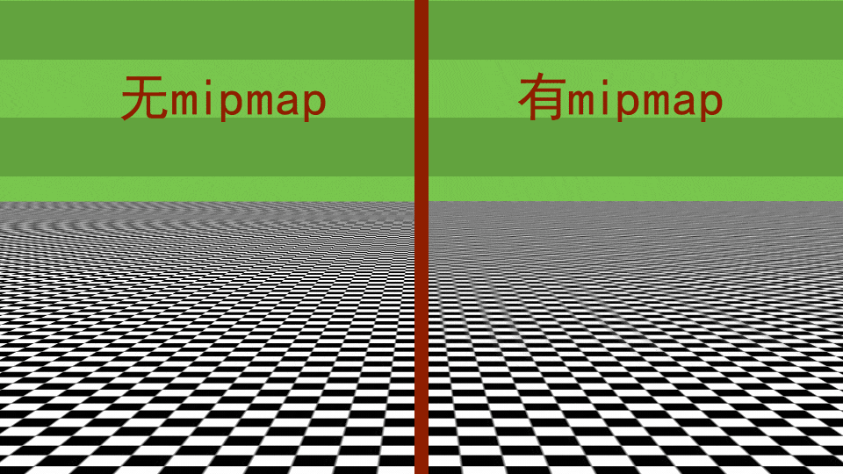
Prefilering
Here is an example showing the difference when Mipmap is activated or not.
So, why this is happening?
No Mipmap
Mipmap
Notes:
Filter out the high frequency part of the texture, to make it smoother

Slide 16

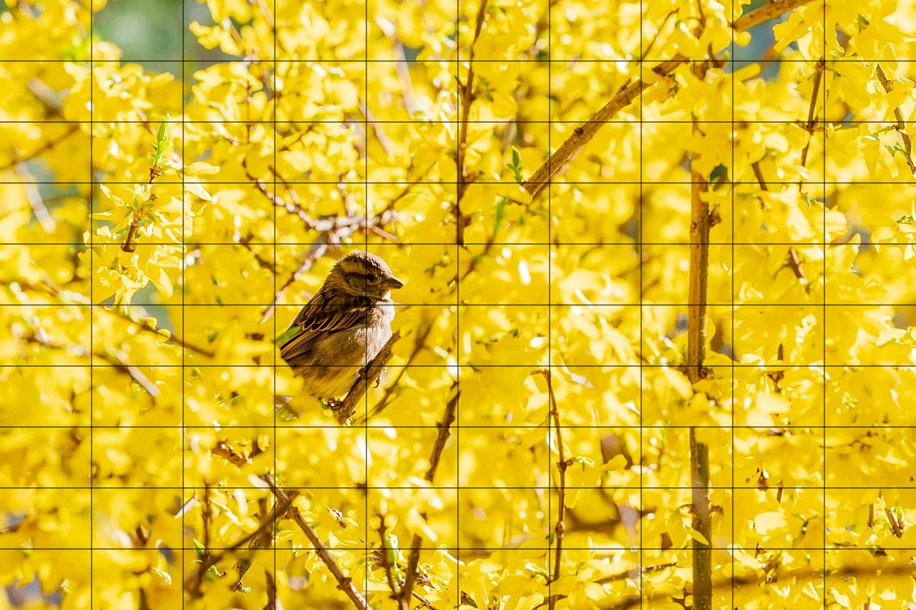
Prefilering
There are two reasons for this “flickering” effect:
Numerical instability of floating point numbers;
Too high frequency signal is given.
The sample grid when getting close to the object
The sample grid when getting far from the object
Notes:
Imagine we have a screen, you render a texture on a vertical plane, and we render in full screen mode, if we get close to the object,
this is not happening in real application I think, but this example is good for understanding this technique.

Slide 17




Prefilering
The floating point instabity problem causes:
The sample grid when getting far from the object

Slide 18

Prefilering
The floating point instabity problem causes:
The sample grid when getting far from the object

Slide 19


Prefilering
But if we have a “prefiltered” version of this image, we can switch to it when we have a low res sample grid.
The sample grid when getting far from the object

Slide 20
Prefilering
Side to side comparison of “Mipmaped” and “Un-Mipmaped” effects in rendering tasks.

Slide 21
Bounding Volume Hierarchy (BVH)
Facts about BVH:
It’s a data structure;
It’s for scene management;
It’s based on binary tree;
It’s based on Axis Aligned Bounding Box (AABB in short);
It’s widely used in computer graphics applications (especially ray tracing APPs)

Slide 22
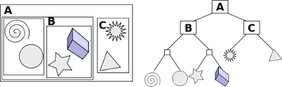
Bounding Volume Hierarchy (BVH)
The construction of a basic BVH tree assuming we have a 3D scene consisting of primitives (user-defined):
From Wikipedia

Slide 23
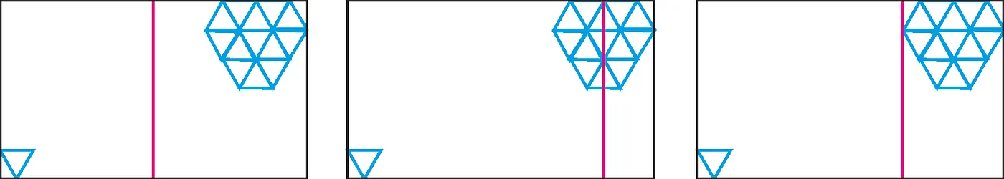
Bounding Volume Hierarchy (BVH)
In basic BVHs, we split the space using the middle primitive, but it’s not always the best case.
Space center as axis
Median primitive as axis
Good
https://medium.com/@bromanz/how-to-create-awesome-accelerators-the-surface-area-heuristic-e14b5dec6160
Notes:
ray shoot包围盒的概率

Slide 24
Bounding Volume Hierarchy (BVH)
In basic BVHs, we split the space using the middle primitive, but it’s not always the best case.
Space center as axis
Median primitive as axis
Good
https://medium.com/@bromanz/how-to-create-awesome-accelerators-the-surface-area-heuristic-e14b5dec6160
Notes:
ray shoot包围盒的概率

Slide 25
Bounding Volume Hierarchy (BVH)
Researchers crave to find the best split axis when primitives are not uniformly distributed in the scene.
For example:
SAH (Surface Area Heuristic for axis finding) (used in this paper to create a BVH)
Outside the BVH realm, there are also many other scene management structure and tricks based on different techs:
KD-Tree
BSP (Binary Space Partitioning)
Octree (Quadtree in 2D cases)
SAH: https://link.springer.com/article/10.1007/BF01911006

Slide 26
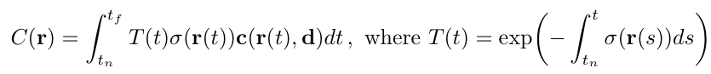
NeRF (Neural Radiance Field, 2020)
NeRF: Representing Scenes as Neural Radiance Fields for View Synthesis.
It’s based on volume rendering.
Ben Mildenhall, Pratul P. Srinivasan, Matthew Tancik, Jonathan T. Barron, Ravi Ramamoorthi, and Ren Ng. 2021. NeRF: representing scenes as neural radiance fields for view synthesis. Commun. ACM 65, 1 (January 2022), 99–106. https://doi.org/10.1145/3503250
Notes:
T is a function

Slide 27
Neural Radiosity (2021)
It take the idea from an old technique called “Radiosity”, the insight is that: Based on the rendering equation, the scene has a final state in which every surface point on every incoming and outgoing directions will follow the rendering equation.
LHS
RHS
LHS equals to RHS on every surface point and ω_{i}, ω_{o}!
Saeed Hadadan, Shuhong Chen, and Matthias Zwicker. 2021. Neural radiosity. ACM Trans. Graph. 40, 6, Article 236 (December 2021), 11 pages. https://doi.org/10.1145/3478513.3480569
Notes:
T is a function

Slide 28
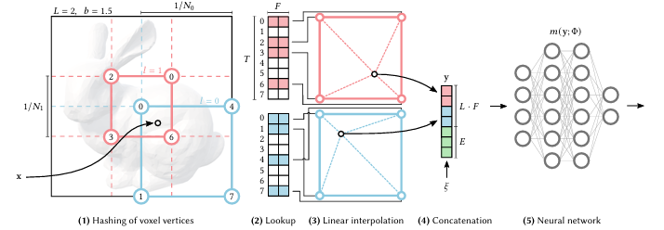
Instant-NGP (2022)
It add a learnt cache on top of NeRF to make the training and rendering faster.
The learnt cache is multiresolution hash grid.
Thomas Müller, Alex Evans, Christoph Schied, and Alexander Keller. 2022. Instant neural graphics primitives with a multiresolution hash encoding. ACM Trans. Graph. 41, 4, Article 102 (July 2022), 15 pages.

Slide 29
Methods
A learnt representation for 3D surfaces with support for efficient ray-intersection queries (generally, they use BVH to achieve this goal).
Intuitively, we have a model M that inplicitly represent the 3D scene, then based on M, the rendering task could be:
Generate inputs for M;
Use inputs to evaluate/infer M;
Render image based on infered information
Notes:
So, in one sentence, this paper purpose a learnt representation for 3D surfaces (INR), 这里可以画个图 on the fly,

Slide 30
Methods
R
Steps (for now):
Prepare a 3D scene S (triangular mesh/...);
Prepare a MLP;
Construct a conventional BVH Acc (SAH is used in the paper) based on S;
Construct a ray R = (o, d);
Do ray intersection test for R and Acc;
Sample along the ray using stratified sampling, and get P = {p₁, p₂, p₃, ...};
For each p_{i} in P, query the underlying multi-res hash grid for feature vectors F = {...};
Concatenate F as the input of MLP;
Evaluate MLP, get output (various information that is needed for rendering)
eye

Slide 31
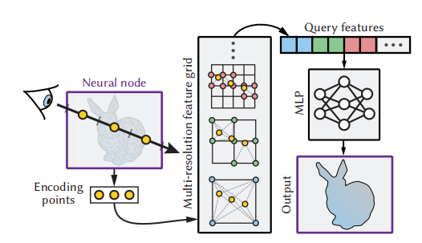
Methods
Their pipeline. This is actually the overall pipeline of their method, which is viable. However, as they state in the paper, just doing stratified point sampling along the ray have performance issues.
Because, if we see the actual geometry surface as the signals that the model want to learn, then the closer the sampled points is with the actual surface position, the better quality the trained model will be.

Slide 32
Methods
Refinement decision: Let the sampled points get as close as possible to the actuall intersection points.
One way to do this is that: make leaf nodes of the BVH smaller.

Slide 33
Methods
Refinement decision: Let the sampled points get as close as possible to the actuall intersection points.
One way to do this is that: make leaf nodes of the BVH smaller.
But, when the leaf nodes become smaller, the BVH gets deeper.
To avoid the BVH gets deeper, the authors make another decision: Use tree cuts to optimize the BVH, which yields N-BVH in this paper.

Slide 34
Methods
N-BVH construction:
Construct a Base-BVH Acc (using SAH) based on the original geometry scene;
Get all the nodes along the current tree cut, N = {node₁, node₂, ...};
Then calculate the node error Errors for every node in N;
Find the indices Ind in Errors with largest Error value;
Replace node_{Ind} with its two childrens in the cut;
Modify the hyperparameters for Error calculation;
Return to step 2, until a target node count is reached.

Slide 35
Methods
The node error is calculated via ranking heuristic:
q: Training loss on this node.
p: Probability of a random ray hitting this node. (estimated by the fraction of training rays that hit the node)
The insight is that:
Priority one: nodes with large loss value need to be devided;
Priority two: big nodes need to be divided.
Notes:
put a 2 to add more punishment on this

Slide 36
Methods
Training process on nodes in the highest level:
For one sampled ray, trace the ray against nodes on cut, find the first intersected node, calculate each nodes’ error, train on the first node intersected with probability max(r/r_{max}, 0.005).
The output of the MLP:
Visibility
Intersection point
Auxiliary intersection data (normal and albedo)
The Loss:
L_{vis}: Binary cross-entropy loss
L_{dist}: L₁ loss, MAE
L_{norm}: L₁ loss, MAE
L_{albedo}: Relative L₂ loss
Notes:
put a 2 to add more punishment on this

Slide 37
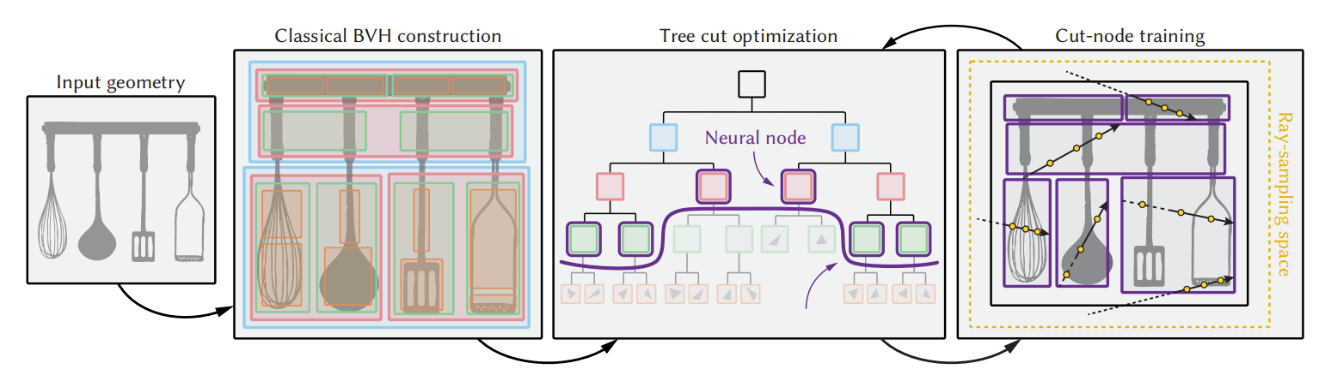
Methods
The pipeline.

Slide 38
Methods
Level of detail could be easily inplemented via N-BVH. Multiple cuts could be set and trained on an N-BVH.
When rendering, select nodes in different cuts for LoD.

Slide 39
Results
This paper implement a hybrid path tracer which has the structure like:
TLAS
BLAS₁
BLAS₂
...
Notes:
自己比了一下 不同的hash grid下的内存占用，以及某一个情况下的，横坐标是渲染时间，纵坐标是image error

Slide 40
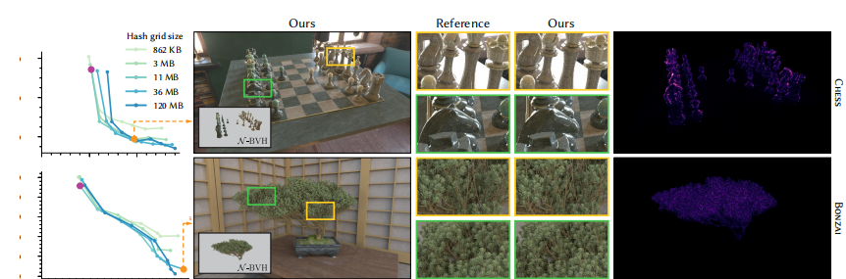
Results
Pontus Andersson, Jim Nilsson, Tomas Akenine-Möller, Magnus Oskarsson, Kalle Åström, and Mark D. Fairchild. 2020. FLIP: A Difference Evaluator for Alternating Images. Proc. ACM Comput. Graph. Interact. Tech. 3, 2, Article 15 (August 2020), 23 pages. https://doi.org/10.1145/3406183
Notes:
自己比了一下 不同的hash grid下的内存占用，以及某一个情况下的，横坐标是渲染时间，纵坐标是image error

Slide 41
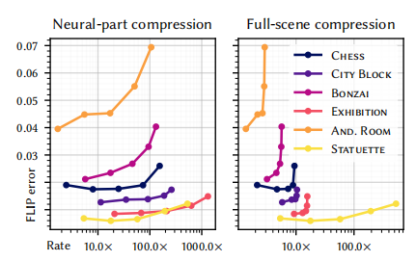
Results
Notes:
自己比了一下 不同的hash grid下的内存占用，以及某一个情况下的，横坐标是渲染时间，纵坐标是image error

Slide 42
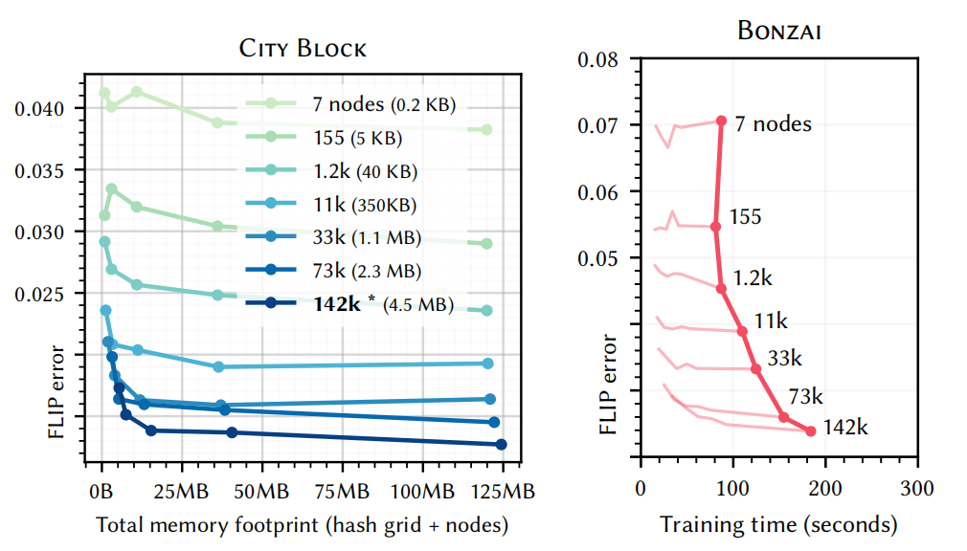
Results
Notes:
自己比了一下 不同的hash grid下的内存占用，以及某一个情况下的，横坐标是渲染时间，纵坐标是image error

Slide 43
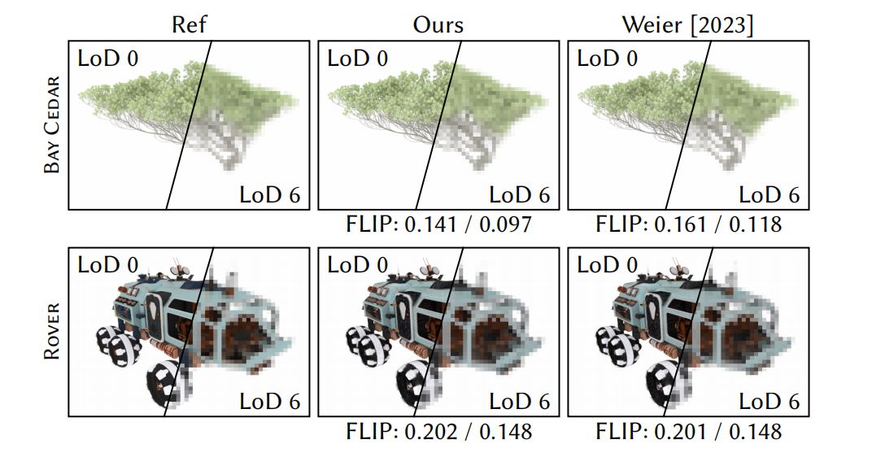
Results
Notes:
自己比了一下 不同的hash grid下的内存占用，以及某一个情况下的，横坐标是渲染时间，纵坐标是image error

Slide 44
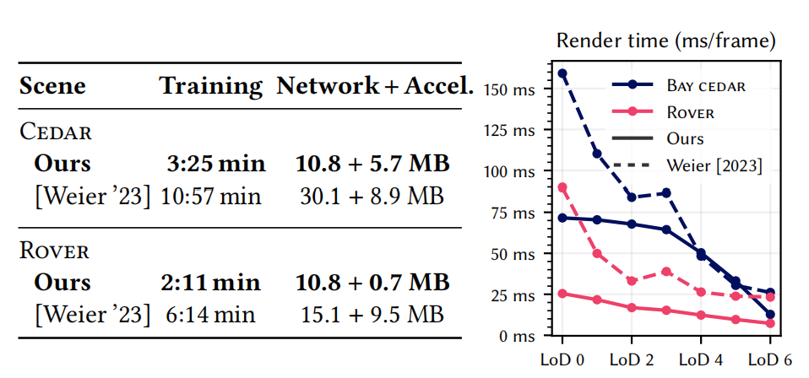
Results
Notes:
自己比了一下 不同的hash grid下的内存占用，以及某一个情况下的，横坐标是渲染时间，纵坐标是image error

Slide 45
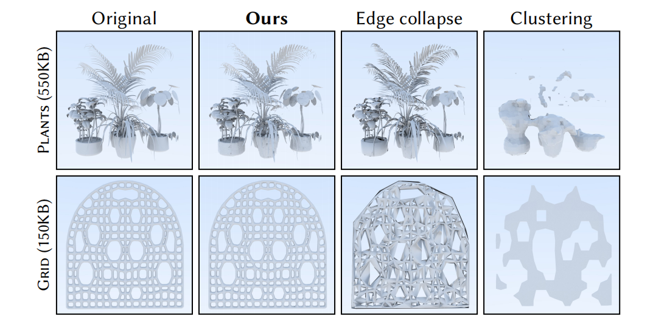
Results

